Slide 1
Presentation [v4] Long Term Emergent Dynamics in Evo-MNCA
Sanyam*Stefano
Østfold University College

Slide 2

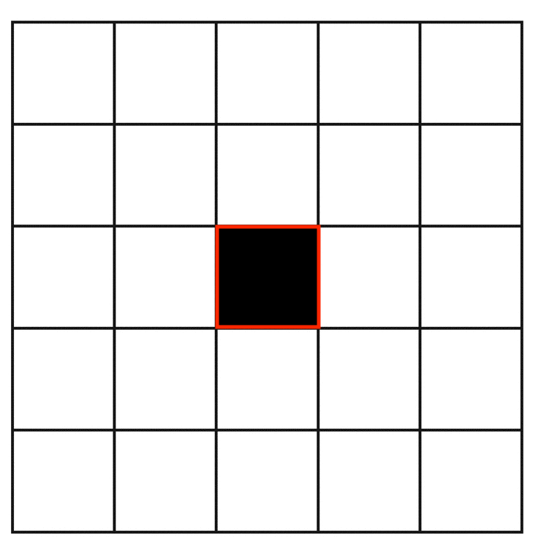
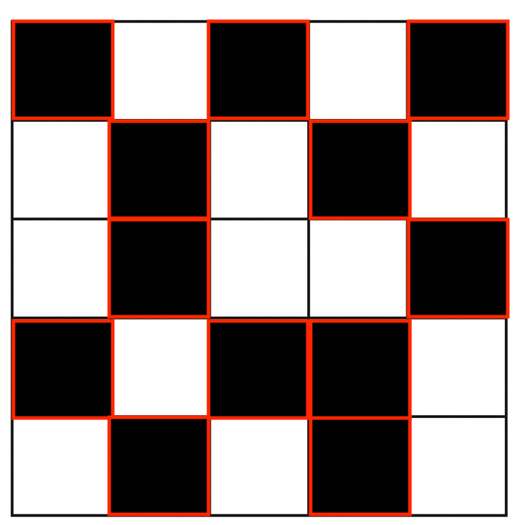
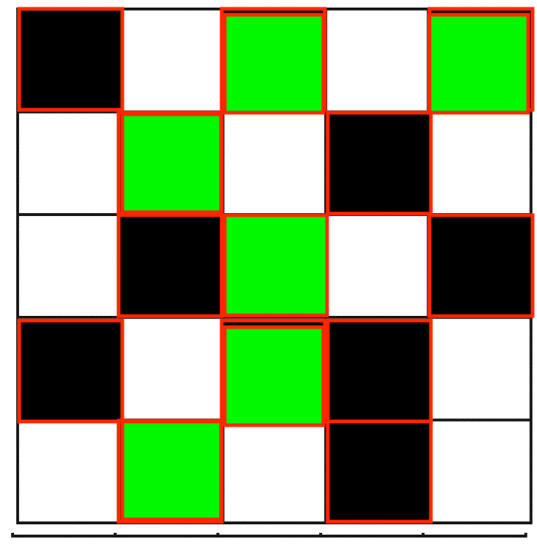
Implementation Details – Cellular Automata
Initial States
Single Active Cell
Random with probability (0,1)
Random with probability (0,1,2)

Slide 3
Implementation Details – Cellular Automata
Fixed Parameters for CA
W = 100
H = 100
Border Conditions = Wrap around or modulo like (we have not fixed the boundary of CA)
init_state = {‘single_cell’, ‘01_rand_probabstic’, ‘012_rand_probastic’}
For CA Steps
Case1: CA Steps = 1-50
Case2: CA Steps = 51-100

Slide 4
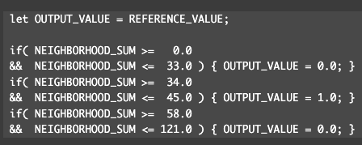
Implementation Details – Cellular Automata
Input to CA function
Now the B and S rules are transformed to B and D rules with the meaning Born and Death, where Born array or B contains rules like [[-,-],[-,-],[-,-]...] and same with D.
D = [[0,33],[58,121]] and B = [[34,45]] And our EC will evolve these lists now, rather than B and S which I had mentioned earlier.

Slide 5
Implementation Details CA Rules – Slackermanz like
Method 1: Evolve or Learn Rules and Fix Neighbors
Method 2: Evolve or Learn Neighbors and Fix Rules (OR Learn Neighbors and Rules both)
Keep method 2 as “project 2”(a completely separate investigation)
We focus on method 1 for this project.

Slide 6
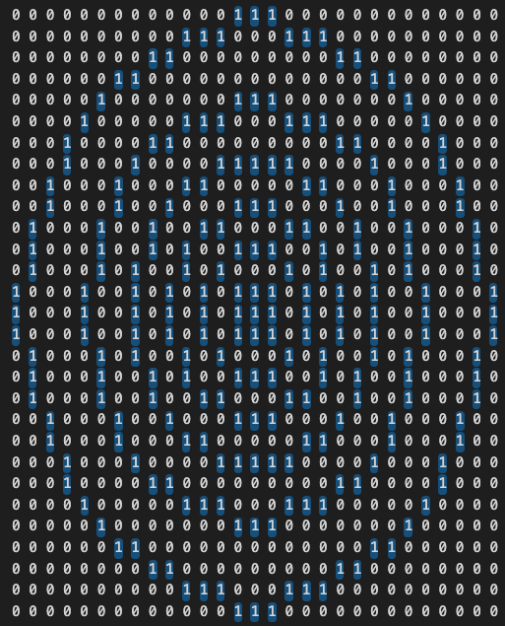
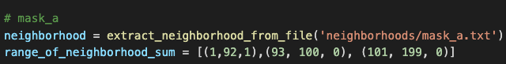
Implementation Details CA Rules – Single Neighborhood
Method 1: Evolve or Learn Rules and Fix Neighbors
Method 1.1 Fix Neighbors, n=1. The version that I already have for now (EMNCAv2 for code reference and look for ppt p3.pptx for results)
Fixing 1 neighbors (mnca_v9.1)
Board
Initialization
1 Neighborhood CA
=
Known neighborhood and rules
200x200
Steps=100
nh1

Slide 7
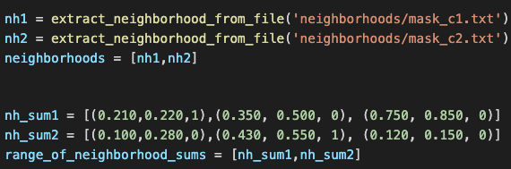
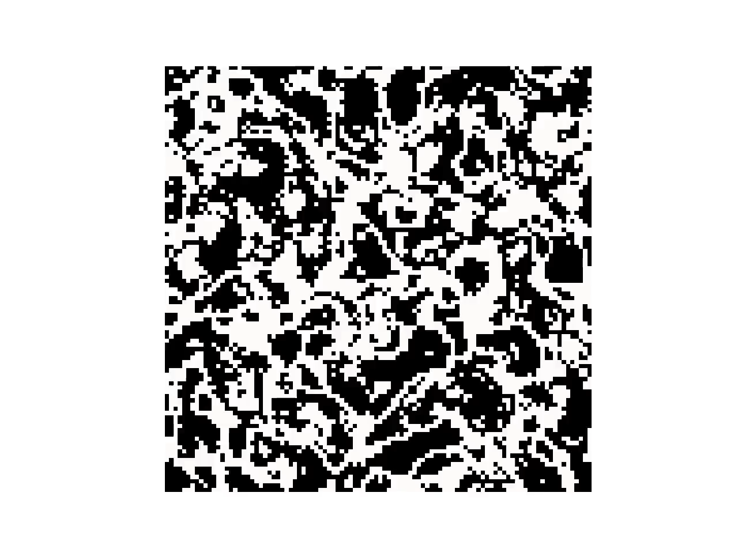

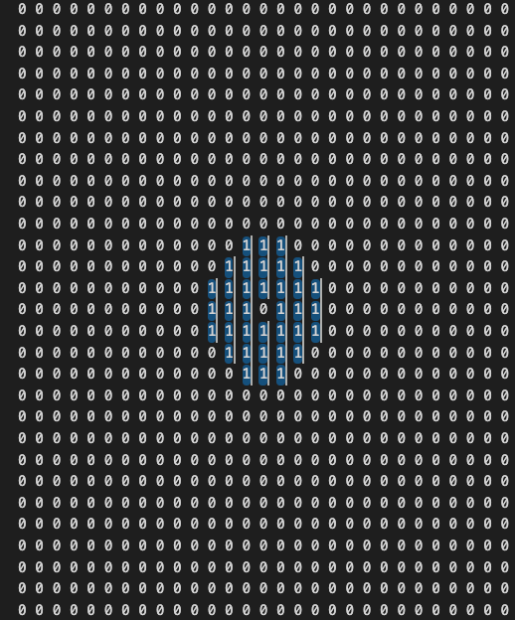
Implementation Details CA Rules – Multi Neighborhood
Board
Initialization
Method 1: Evolve or Learn Rules and Fix Neighbors
Method 1.2 Fix Multiple Neighbors
Method 1.2.1 Having Neighbors as TXT file
Fixing multiple neighbors (mnca_v9.2)
There is flexibility to add more neighbors
=
+
Mask_c1.txt
Mask_c2.txt
Ran for 200 steps (100x100)
Known Rule from slackermanz

Slide 8
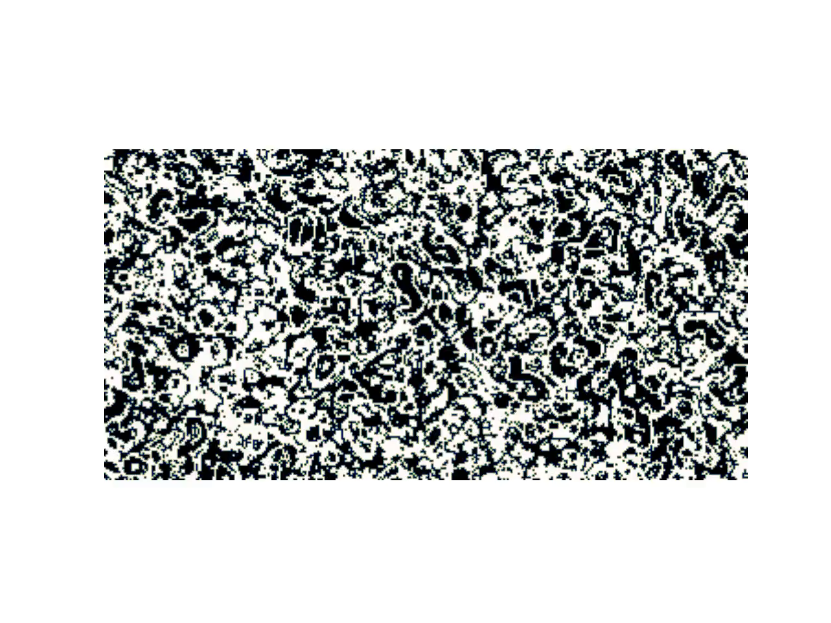
Previous slide’s Known rule with w=350, h=180, steps = 600, fps = 20, random cell with probability (2 states)
nh_avg1 = [(0.185,0.200,1),(0.343, 0.580, 0), (0.750, 0.850, 0), (0.150, 0.180, 0)]
nh_avg2 = [(0.150,0.280,0),(0.445, 0.680, 1)]

Slide 9
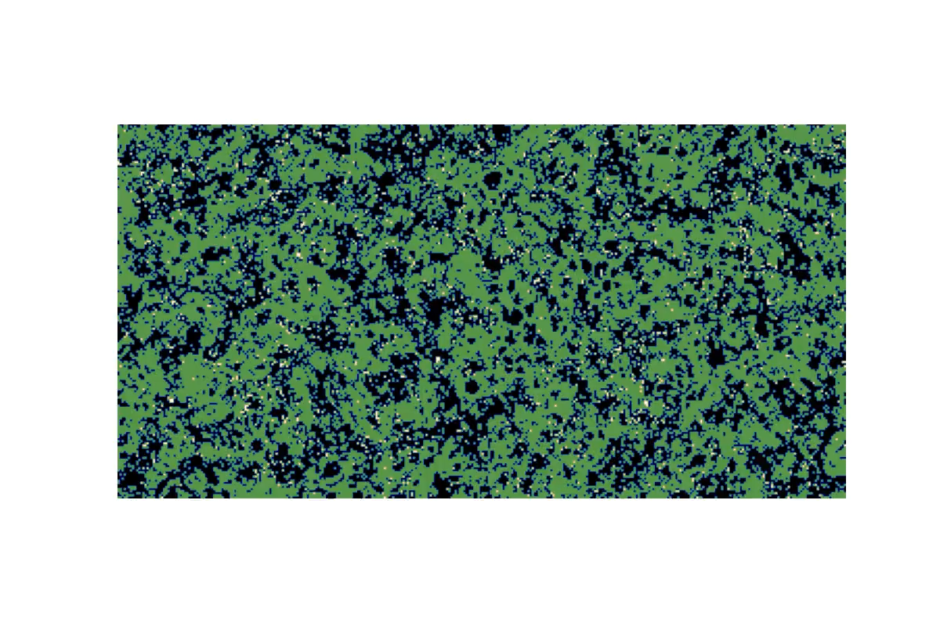
Previous slide’s Known rule with w=350, h=180, steps = 600, fps = 20, random cells with 3 different states (3 states)
nh_avg1 = [(0.185,0.200,1),(0.343, 0.580, 0), (0.750, 0.850, 0), (0.150, 0.180, 0)]
nh_avg2 = [(0.150,0.280,0),(0.445, 0.680, 1)]

Slide 10
Implementation Details CA Rules – Multi Neighborhood
Method 1: Evolve or Learn Rules and Fix Neighbors
Method 1.2 Fix Multiple Neighbors
Method 1.2.2 Generate Neighbors at runtime
R=1
R=2
R=1+2

Slide 11
Implementation Details CA Rules – Multi Neighborhood
Method 1: Evolve or Learn Rules and Fix Neighbors
Method 1.2 Fix Multiple Neighbors
Method 1.2.2 Generate Neighbors at runtime
I also want to make a note that Method 1.2.2 Generate Neighbors at runtime (slide 8) is redundant for analysis and EC, as generating these neighbors at runtime are equivalent to the neighbors that are stored in the available neighborhood txt files. Moreover we can just use 1,2 or any of them as required. Because we have flexiblity to do that. We discuss this next time in more details.
R=1
R=2
R=1+2

Slide 12
How are we introducing Multiple States to the MNCA:
By introducing a new state as part of rules:
Rules look like for Single Neighborhood CA with radius 5(for example):
If(0<nh_sum<33): {result 1}
If(34<nh_sum<49): {result 0}
If(50<nh_sum<122): {result 2}
We can have a parameter for number of states as ‘nos’
‘nos’ = 2 ➔ {0,1} is the set of possible states that CA can take
‘nos’ = 3 ➔ {0,1,2} is the set of possible states that CA can take
Not r=5 CA (only example)

Slide 13
How a rule looks like (example rule for 0-1 state Single Neighborhood CA):
# Rule Set goes here
if(neighbors_sum>=0 and neighbors_sum<=33):
cells_arr[i][j] = 0
elif(neighbors_sum>=34 and neighbors_sum<=45):
cells_arr[i][j] = 1
elif(neighbors_sum>=58 and neighbors_sum<=121):
cells_arr[i][j] = 0
Neighbors_sum can also be changed to neighbors_average as per requirement in MNCA

Slide 14
Implementation Details – Frequency Histogram Coarse Graining
What if instead of the deflate of a certain number of states (let’s say 50) we use the deflate of the coarse-grained (frequency histogram based) states instead?
Importance of threshold – supercells with low p_{i} with high self information
are mapped with 1, where are commonly occuring states are mapped to 0
Cisneros, H., Sivic, J., & Mikolov, T. (2021). Visualizing computation in large-scale cellular automata. arXiv preprint arXiv:2104.01008.

Slide 15
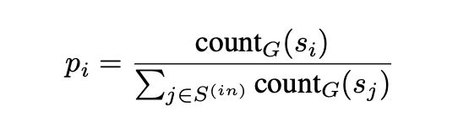
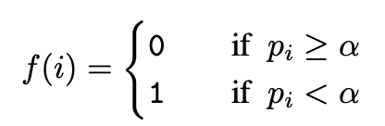
Mathematics behind frequency based CG
Step1 Convert NxN to smaller arrays of 2x2. (Block Shaped of 2)
Input = board_array -> size=100*100
Output = board_array -> size 50*50
Step2
Cisneros, H., Sivic, J., & Mikolov, T. (2021). Visualizing computation in large-scale cellular automata. arXiv preprint arXiv:2104.01008.

Slide 16
Can we also put a threshold of DEFALTE to some point? So that we do not reach chaotic behaviors? Not sure.
We will know based on the experiments. We shall be able to check the curve where the steepness starts to normalize and where the crve stops growing further.

Slide 17
Implementation Details – EC
We provide population_size, generation_size as parameter
Python3 EC.py [population_size] [generation_size]
It returns:
Born and Death rules (where we put 1 and 0 respectively)
There is a flexibility of having Born, Survive and Death rules (where we put 1, 2, and 0 respectively)

Slide 18
Implementation Details – EC – init pop
Intial Pop - [[B],[D]] where:
B = random_list_generator(1,radius_cell_sum) with random size
D = random_list_generator(1, radius_cell_sum) with random size
Radius_cell_sum =maximum possible value within range
If r=1, it is 8
If r=2, it is 24
If r=3, it is 48
If r=4, it is 80
Deflate = cellularautomata(B,S) as cellulatautomata function runs 50 steps of CA and concat to save a file “boardArray.txt” and returns compressed.sizeof() which is deflate value.

Slide 19
Implementation Details – EC - Crossover
We skip for now

Slide 20
Implementation Details – EC - Mutation
Update Mutation with following changes, that is add following definition of mutation in mutation function definition of the code so that mutation can be done via:
Inserting a value in the rule ("Gene") by using clone and mutate, because to find probability of adding a new gene to the rule should be based on the probability of already existing gene.
Remove a value from the rule based on probability of the gene / value already there in the rule.
Change a value from the rule based on probability of the gene / value already there in the rule.

Slide 21
Implementation Details – EC - Selection
Proportionate Selection
Roulette wheel selection

Slide 22
Experimental Setup of EMNCA with:
Vanilla DEFLATE
DEFLATE on High and small mutation
DEFLATE on Large and small population
DEFLATE on First 50 CA steps (1-50)
DEFLATE on Next 50 CA steps (51-100)
Coarse Graining (2x2) on MNCA + Coarse Graining (2x2) on same MNCA again + DEFLATE
Coarse Graining(block Size, Threshold) + DEFLATE
Coarse Graining For 2x2 size, threshold = 1 + DEFLATE
Coarse Graining For 2x2 size, threshold = 2 + DEFLATE
Coarse Graining For 2x2 size, threshold = 3 + DEFLATE
Coarse Graining For 3x3 size, threshold = 1 + DEFLATE
Coarse Graining For 3x3 size, threshold = 2 + DEFLATE
Coarse Graining For 3x3 size, threshold = 3 + DEFLATE
Coarse Graining For 3x3 size, threshold = 4 + DEFLATE
Coarse Graining For 3x3 size, threshold = 5 + DEFLATE
Coarse Graining For 3x3 size, threshold = 6 + DEFLATE
Coarse Graining For 3x3 size, threshold = 7 + DEFLATE
May be for later stage:
Joint Compression instead of DEFLATE
Large and Small Crossover

Slide 23
Misc Suggestions - Technical
Output videos should be longer.
Comment Crossover for now and keep it in queue for discussion at later stage of the project.
Difficult to say that 50 generations is enough. Let us try experimentally and see what is the number of generations to get a “convergence”.
Consider a one more for loop / run the EC.py file multiple times and record the outputs (lowest, mean and best deflates) and make another curve so that we can verify it is not just a lucky case that we are getting.
(From slide 5th) Method 2: Evolve or Learn Neighbors and Fix Rules (OR Learn Neighbors and Rules both)

Slide 24
Misc Suggestions – Logistics
ASCAT2024 (Oct 2023 submission may opens), Advances in CA (advances in cellular automata, Andrew chapter 1st June 2023)
PhD related information.
Summer work if not with HiØ, Stefano suggested he may plan for company collaboration
Also look how one proceed for PhD in Norway (Competition is high)

